Slide 1

SMART INDIA HACKATHON 2026
TITLE PAGE
Problem Statement ID – SIH26133
Problem Statement Title – Accessibility and Quality of public healthcare services, particularly in rural and underserved areas .
Theme – Medtech / Biotech / Healthtech
PS Category - Software
Team ID -
Team Name (Registered on portal) – 6_Rays

Slide 2
Jeeva Setu - Connecting patients, health workers & doctors
6_RAYS
Proposed solution :
A digital health platform for the Government that transforms periodic rural health-survey measurements into unified longitudinal patient records, enabling continuous health-trend monitoring and informed clinical follow-up.
Detailed Proposed Solution
Unique Patient ID connects all health records across visits.
Mobile platform captures BP, SpO₂, HR, glucose, Hb, temperature & RR.
Records are stored locally and synchronized when connectivity returns.
Authorized doctors access history and visualized trends.
How It Addresses the Problem
Converts isolated survey readings into a continuous patient health history.
Enables doctors to compare current and previous readings.
Reduces dependence on paper records and continuous internet.
Helps identify changes in health trajectory for clinical follow-up.
Innovation & Uniqueness
Longitudinal tracking instead of one-time health surveys.
Offline-to-online synchronization for low-connectivity regions.
Multi-parameter, patient-centric health profile.
Device-agnostic & scalable architecture.

Slide 3
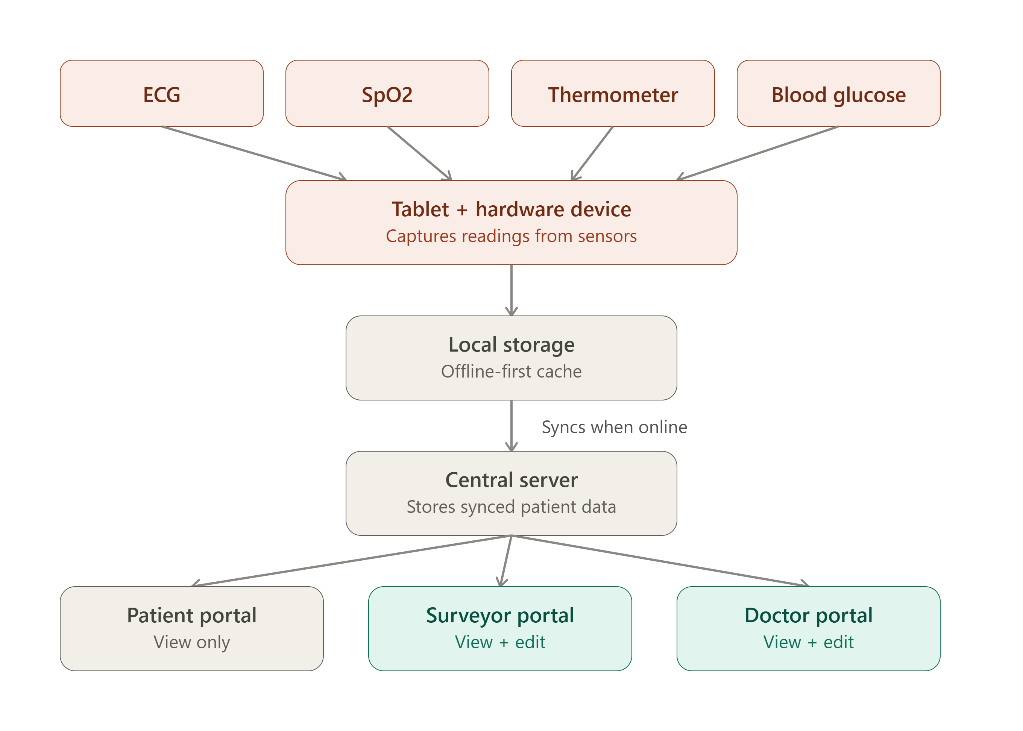
TECHNICAL APPROACH
6_RAYS
Frontend: HTML & CSS – User interface and dashboards
Backend: Python – Server-side processing, APIs & authentication
Database: Stores patient records and medical data
IoT: ESP32 + biomedical sensors – Data acquisition
Communication: Wireless data transmission
Analytics: Risk assessment & health trend analysis
Security: Role-based access and secure data handling.

Slide 4
FEASIBILITY AND VIABILITY
6_RAYS
CHALLENGES / RISKS
Low Connectivity – Unreliable internet in rural areas
Data Accuracy – Manual entry/device variation
Device Compatibility – Different biomedical devices
Privacy & Security – Sensitive patient information
User Adoption – Training and usability
FEASIBILITY
Existing Technology – Uses smartphones, databases & portable medical devices
Low Infrastructure – Minimal additional hardware required
Scalable Architecture – Village → PHC → District
Prototype Feasible – Can initially use simulated/device data
Easy Deployment – Mobile-based health-worker workflow
MITIGATION STRATEGIES
Offline-First Architecture – Local storage with automatic sync
Validation & Range Checks – Prevent invalid readings
Device-Agnostic Design – Standard APIs + manual entry fallback
Encryption + Role-Based Access
Simple UI + Regional Language Support

Slide 5
IMPACT AND BENEFITS
6_RAYS
FIELD-LEVEL INNOVATION
Offline-First Screening Collect vitals even without network connectivity.
Multi-Parameter Capture ECG • SpO₂ • Temperature • Blood Glucose
Less Human Error Direct sensor-to-digital data reduces manual entry.
Portable Field Solution Tablet + integrated health-monitoring hardware.
SMART DIGITAL ECOSYSTEM
One Connected Record Patient data flows from sensors → app → server.
Automatic Sync Offline records sync when connectivity returns.
Three-Role Ecosystem Patient • Surveyor • Doctor
Controlled Editing Patients view; authorized staff can update records.
HEALTHCARE IMPACT
Healthcare Beyond Connectivity Brings digital screening to remote communities.
Faster Clinical Response Doctors can review field data without waiting for paperwork.
Continuity of Care Health records remain available beyond the initial screening.
Scalable Public Healthcare Can expand across villages, camps and healthcare programs.

Slide 6
RESEARCH AND REFERENCES
6_RAYS
Ensuring Access to Quality Health Care in Vulnerable Communities — Bhatt - et al., — Academic Medicine (2018).
Disparities in Healthcare Access: Addressing Systemic Barriers in Urban and Rural Communities — Afni —et al ., Journal of Health Literacy and Qualitative Research (2023).
Availability and Accessibility of Primary Care for the Remote, Rural, and Poor Population of Indonesia — Wenang et al., — Frontiers in Public Health (2021).
Improving Health and Health Care in Rural Communities: A Position Paper From the American College of Physicians — Serchen et al., — Annals of Internal Medicine (2025)
Access to health services and health inequalities in remote and rural areasObehi O Osadolor et al., 2022
Janaki Medical College Journal of Medical Science 10 (2), 70-74
6. Healthcare managerial challenges in rural and underserved areas: A Review Oloruntoba Babawarun et al., 2024 World Journal of Biology Pharmacy and Health Sciences 17 (2), 323-330

